Slide 1
Sentiment Analysis of Persian Language: Review of Algorithms, Approaches, and Datasets
Ali Nazarizadeh1 and Touraj Banirostam2 and Mino Sayyadpour
Group Number: 01
21241057 Malika Muradi
RA: Sania Azhmee Bhuiyan
ST: Abid Hossain

Slide 2
Objectives:
Provide an overview of sentiment analysis and its significance in understanding public opinion, customer feedback, and social media trends.
Explore the specific challenges
Review various approaches and algorithms

Slide 3
Challenges :
Complex Grammar and Syntax
Lexical Ambiguity
Lack of Annotated Datasets
Limited Sentiment Lexicons
Cultural and Contextual Sensitivity

Slide 4
Methodology
Data collection
Literature Review
Evaluation Metrics
Dataset Analysis
Data preprocessing
Annotation
Labeling
Analyzing
Modg the data
Model Evaluation

Slide 5
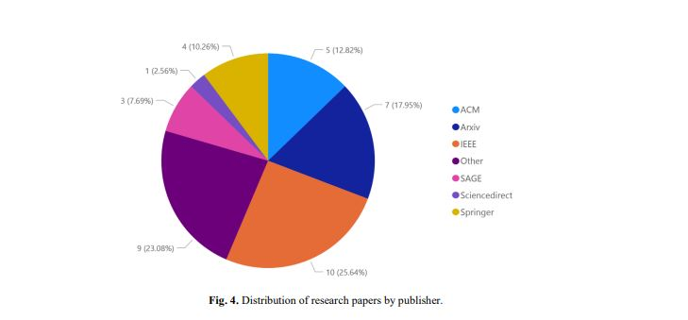
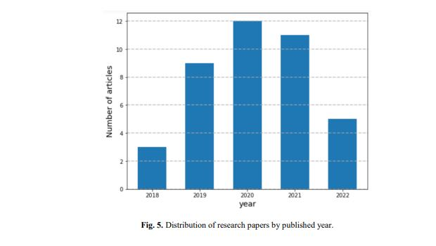
Conclusion

Slide 6
Future Work:
Development of Larger Annotated Datasets
Fine-Grained Sentiment Analysis
Contextual and Cultural Adaptation

Slide 7
THANK YOU

